Slide 1

Gallery Vault An Android Application

Slide 2
Introduction:
Gallery Vault is a privacy protection app that allows user to hide images and videos in an encrypted manner.
Gallery Vault can hide its content and keep your privacy absolutely safe. You can import your private images and videos in this secure vault, and nobody knows the existence of it.

Slide 3
Objectives:
This project contains following objectives:
To keep data safe from prying eyes with strong password features
To hide photos and videos from gallery
Providing a quick means of privacy
To reduce the worry about data security
To edit the selected photo or video (such as crop , zoom etc )
Trying to make it better than the other existing photo video hiding apps

Slide 4
Motivations and Significance:
When you choose to go with snoopy roommates or kids, it is essential to assure security on your media files.
Selected gallery media can be bypassed without too much effort.
Its not the end of the world but more of a heads up that this world aren’t infinitely secured.
This app provides short term privacy benefits.
There is no storage limitation while securing your media files.

Slide 5
Features:
Hides media files –
i) photo
ii)video
These files will not appear in gallery.
Whenever you want, you can unhide your secret hidden files from application.
This application is password protected . So one can’t access your files unless he knows the password.
You can open hidden files from the application without unhide them.
Eye catching UI to manage hidden files from the application.
Multiple hide and unhide option.

Slide 6
Features:
This application offers incognito browser, direct sharing, rating in play store.
Provides feedback opportunity to user.
Private camera is included.
Simple editing features has been added.
Android studio project
Supports up to Android 7
Fully material design

Slide 7
Diagram of Hide-unhide Part:
Start Application
Hide
Unhide
Gallery
Image/video file
Import
restore
Image/
Video file
Gallery
image
image

Slide 8
Development Tools:
Platform used: Android
Technology used: Java

Slide 9
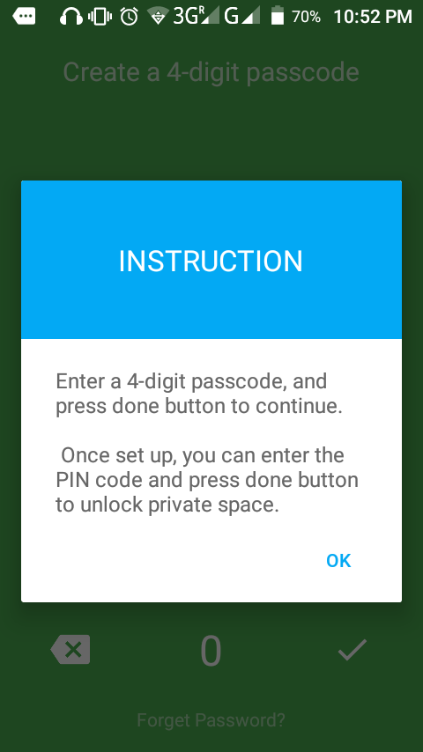
Experimental Samples:
Snapshot of instruction after installation:

Slide 10
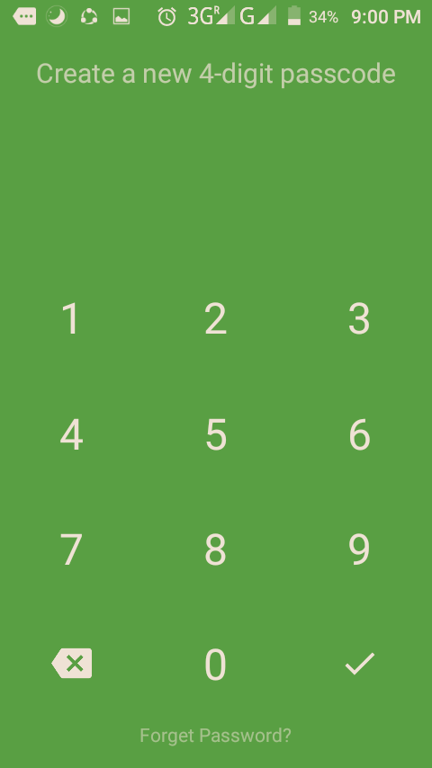
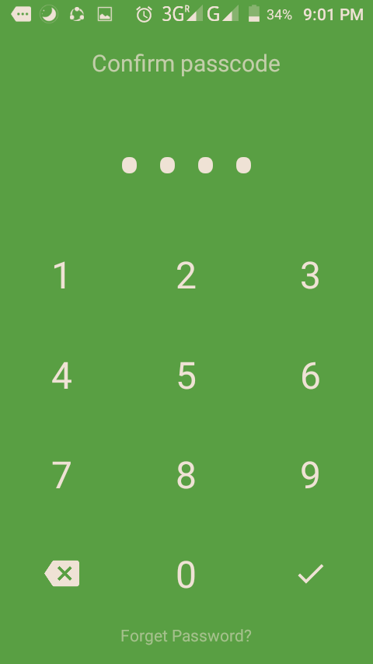
Experimental Samples:
Snapshots of creating and confirming passcode :

Slide 11
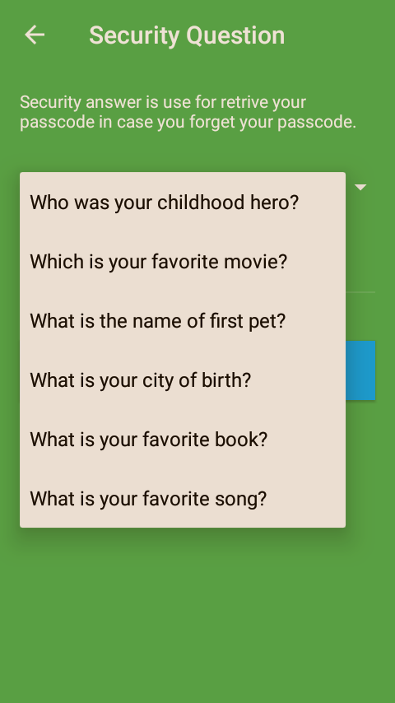
Experimental Sample:
Snapshot of privacy concern if any user forgets his passcode:

Slide 12
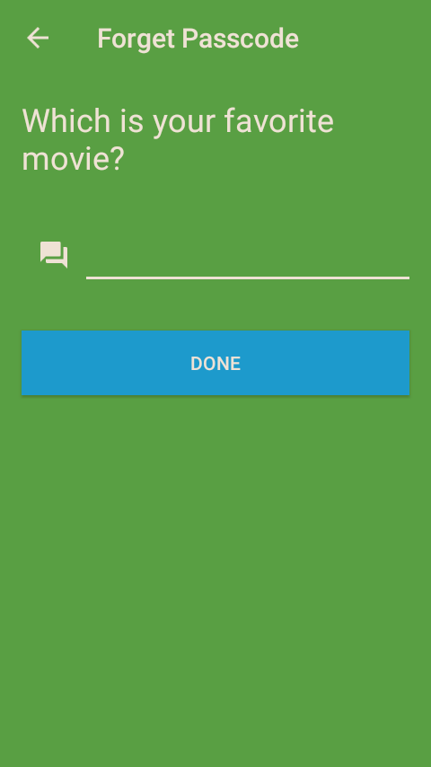
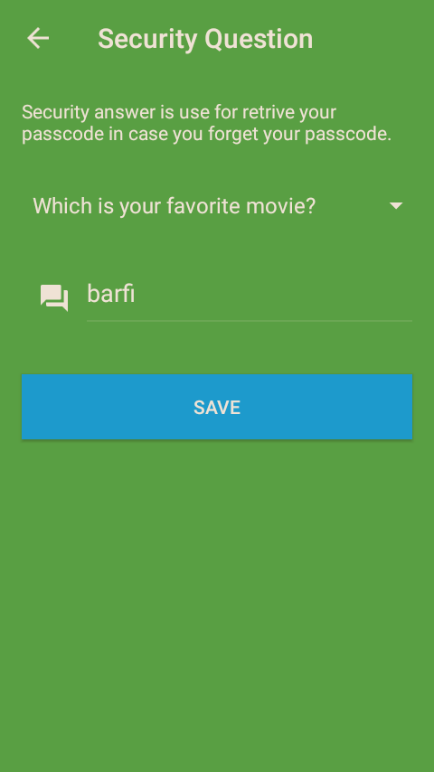
Experimental Samples:
Snapshots of security question:

Slide 13
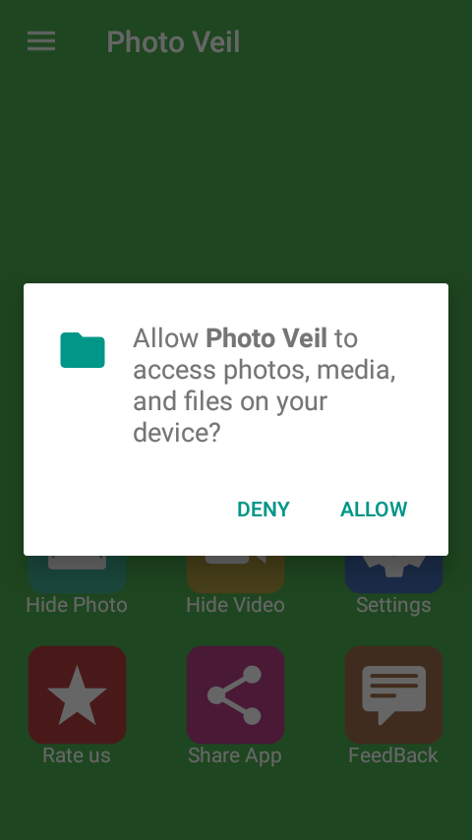
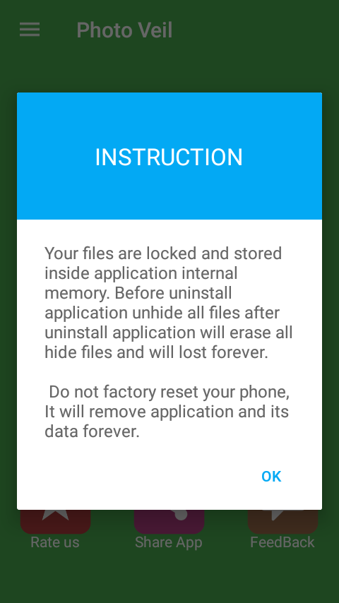
Experimental Samples:
Snapshots of some instructions and getting permission from user of accessing files :

Slide 14
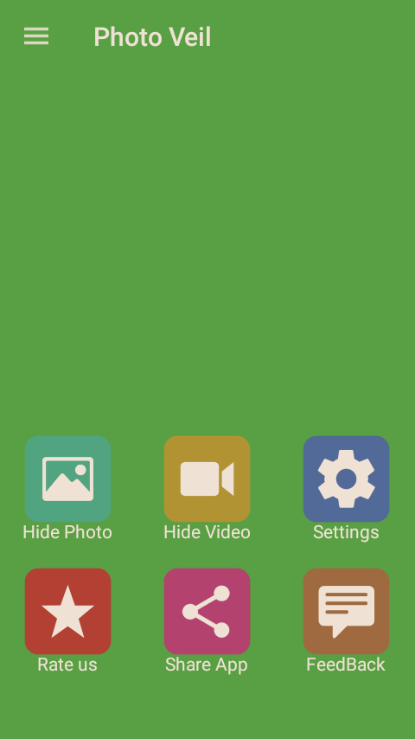
Experimental Sample:
Snapshot of item folder for various purposes:

Slide 15
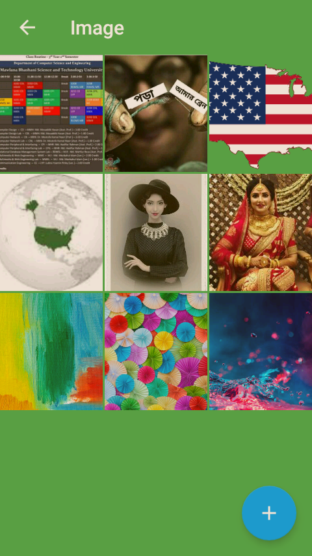
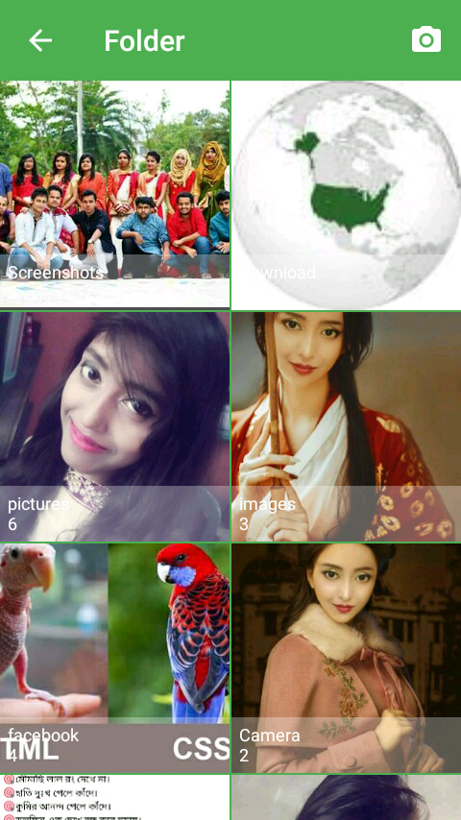
Experimental Samples:
Snapshots of importing images from gallery and hiding images:

Slide 16

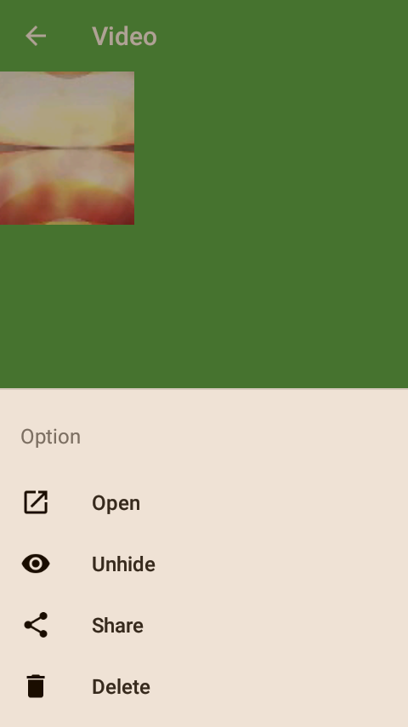
Experimental Samples:
Snapshots of individual file open , unhide , delete and share :

Slide 17
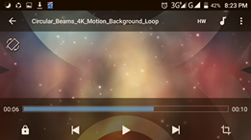
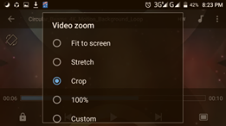
Experimental Samples:
Snapshots of simple editing in video file:

Slide 18
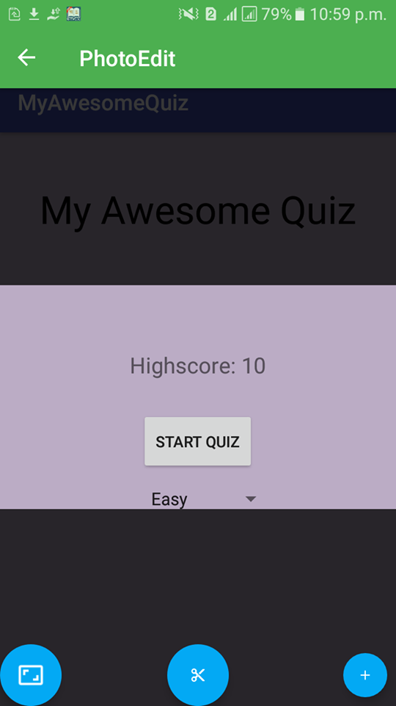
Experimental Sample:
1:1,6:4 and 16:9 ratios are used in cropping images.
Snapshot of editing photo:

Slide 19
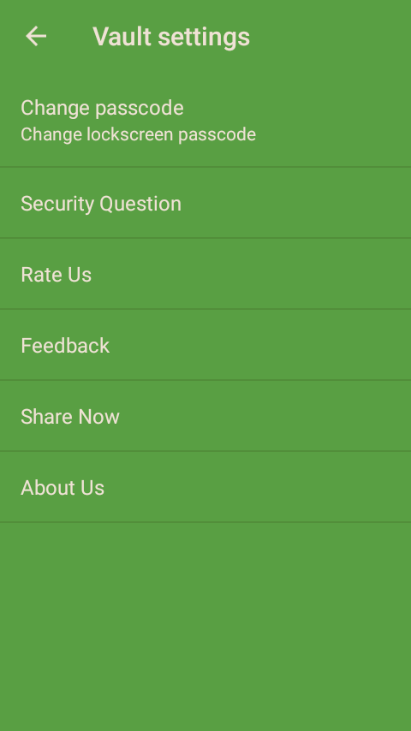
Experimental Sample:
Snapshot of Vault settings:

Slide 20

Experimental Sample:
Snapshot of About activity:

Slide 21
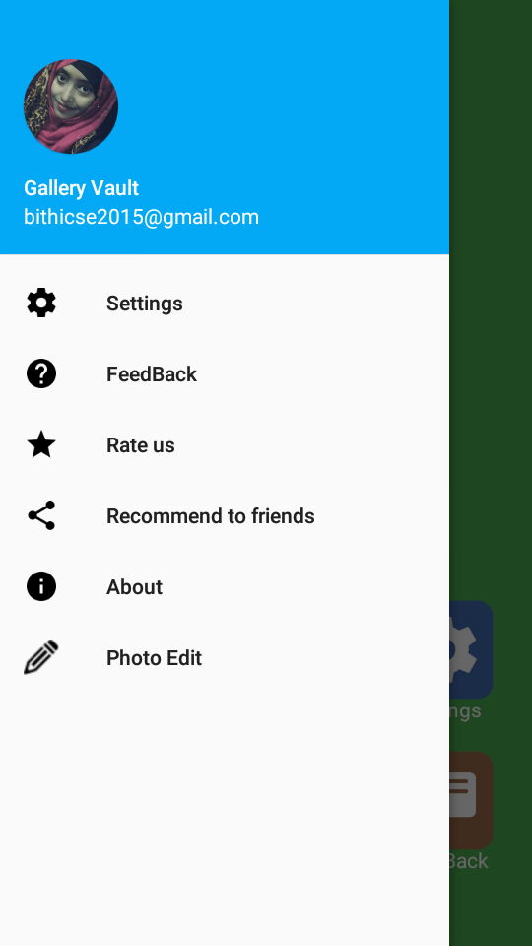
Experimental Sample:
Snapshot of navigation drawer:

Slide 22
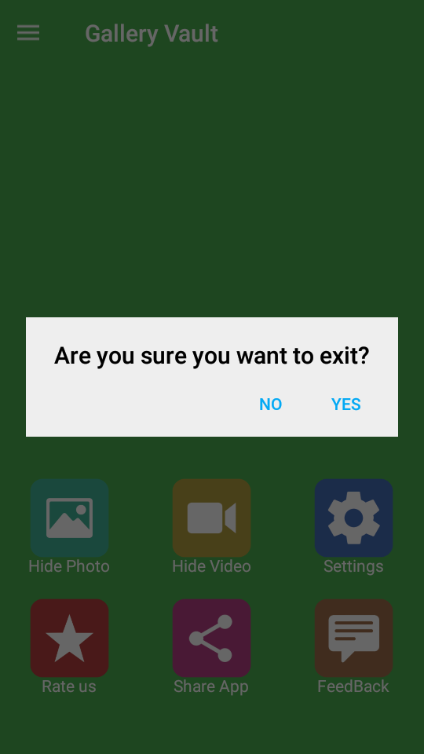
Experimental Sample:
Snapshot of alert box before exiting the app :

Slide 23
Limitations of the project:
Hidden files are not stored online.
Finger print scanner isn’t supported.
No online backup services to restore images getting deleted.
Only English language is supported.

Slide 24
Upcoming features:
Finger print scanner support can be provided.
Using artificial Intelligence, development team can try to make some improvements on privacy terms.
In future, this project will extend to add other files and also some features such as making photo slides, online backup etc.

Slide 25
Conclusion:
The Gallery Vault app works on smart UI to keep user’s data safe with extensive security features. It is very difficult to recover the hidden image for the third party without knowing the password. Finally it can be concluded that this app provides you the smooth and amazing media browse experience.

Slide 26
References:
[1]. Satinsown,D.”Cryptography:Theory and practice”
[2]. RatinderKaur,V.K.Banga “Image Security using Encryption based Algorithm” International Conference on Trends in Electrical,Electronics and Power Engineering(ICTEEP 2012)July 15-16,2012 Singapore.
[3]. Zaidoon kh.AL-Ani, A.A.Zaidan, B.B.Zaidan and Hamdan.O.Alanazi “Overview: Main Fundamentals for Steganography” Journal of computing,Volume 2,Issue 3,March 2010 ISSN 2151-9617

Slide 27
Thanks to all…. ☺

Slide 28
Any Question???

